Slide 1
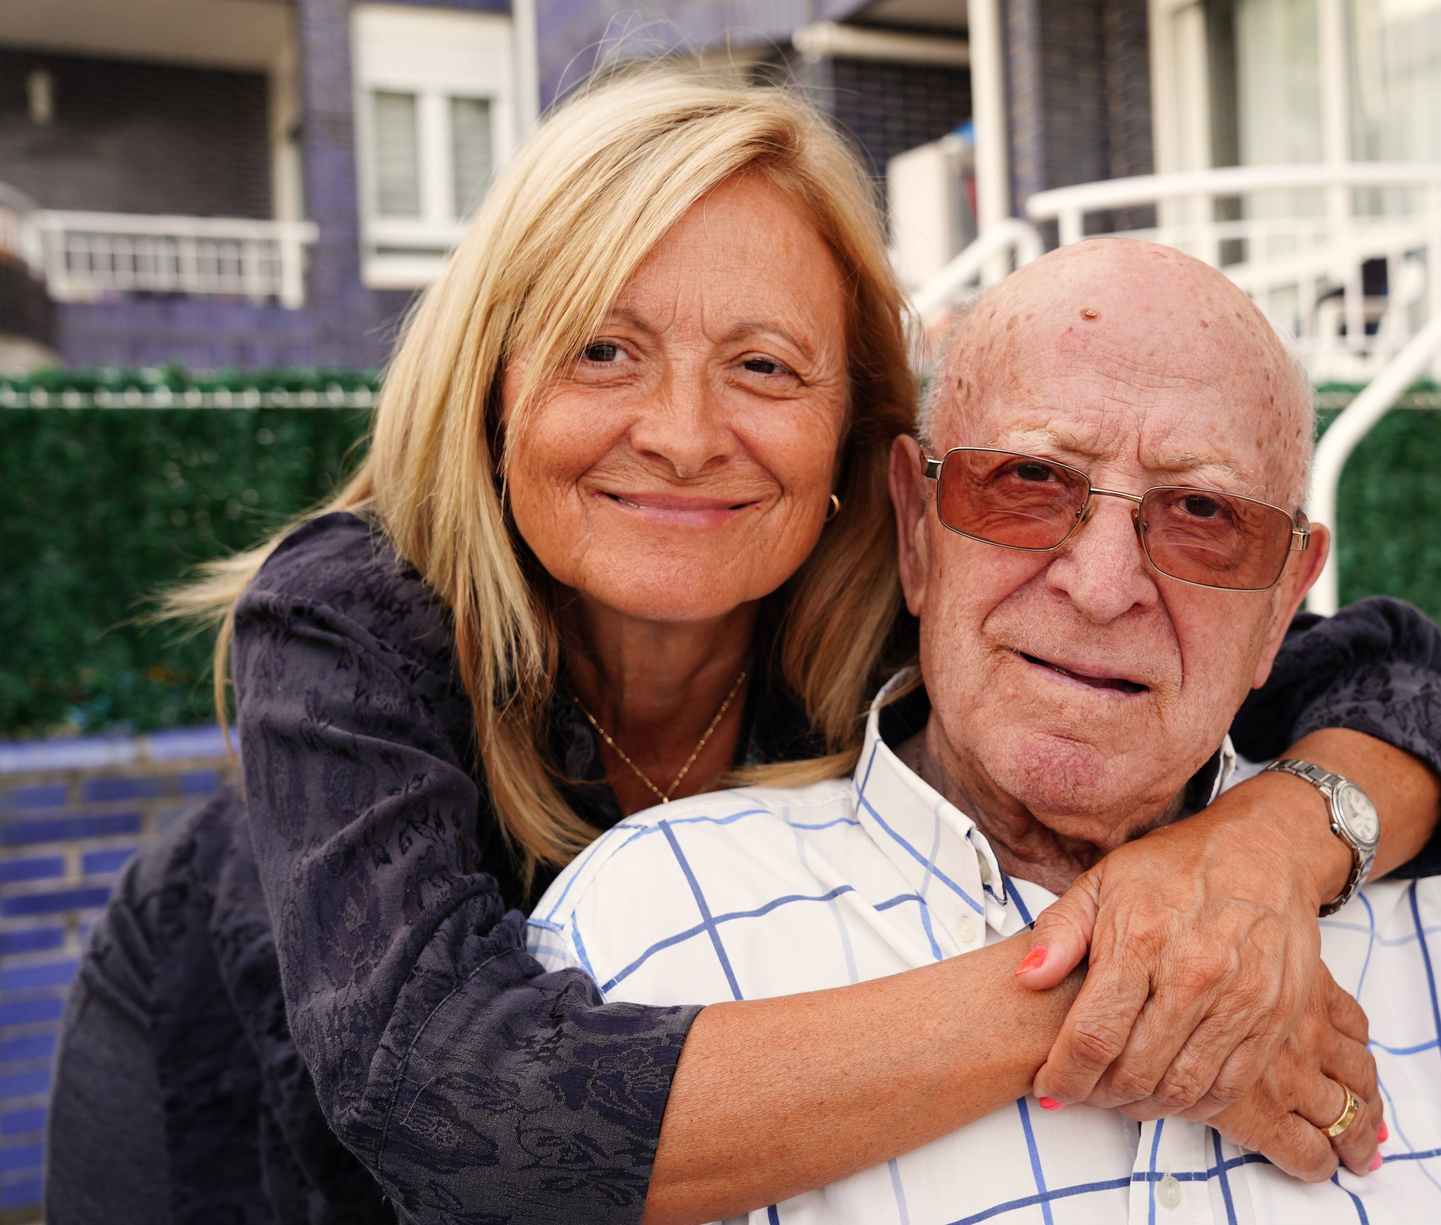

Supporting B.C. Seniors
Key Issues and Challenges
Dan Levitt
BC Seniors Advocate

Slide 2
Role and Mandate
Office of the Seniors Advocate (OSA) was created in 2014 under the authority of the Seniors Advocate Act.
OSA is mandated to address systemic issues related to seniors (65+) in areas of health care, housing, transportation, income and personal care.
Under the Act, the Seniors Advocate has a duty to advise, in an independent manner, the Minister responsible for seniors, public officials, and persons who deliver seniors services.
To fulfill our legislated mandate, there are four main areas of activity:
  Outreach and engagement
  Information and referral
  Monitoring seniors’ services
  Reviewing and reporting on systemic issues

Slide 3



Information and Referral
Toll free information and referral line staffed by seniors’ services specialists provides:
Referrals to government and community services
Responses to requests for information
Guidance on navigating the health care system
Advice on appropriate pathways to escalate concerns
Prioritizing issues for further OSA research and analysis
1-877-952-3181
info@
seniorsadvocatebc.ca
www.seniorsadvocatebc.ca

Slide 4



Snapshot of B.C. Seniors
4
TODAY
1,100,000
AGE 80
12% OF ALL SENIORS
BY 2036
1,516,000
AGE 90
17% OF ALL SENIORS
Total Population 65+
Oldest Baby Boomer
% Seniors 85+
Notes:
Today – 2023 estimate (from BC Stats PEOPLE)
By 2036 – Statistics Canada, M2 growth scenario

Slide 5





Snapshot of B.C. Seniors
  95% aged 65+ live independently
    77% aged 85+
  15% of seniors are employed
01
02
  80% have a driver’s licence
    9% aged 85+ live in assisted living
    13% aged 85+ live in long-term care
03
04
05
5% diagnosed with dementia
  80% are homeowners
06
07
Notes:
Volunteer rate (2018) – General Social Survey – new data coming in 2025.

Slide 6

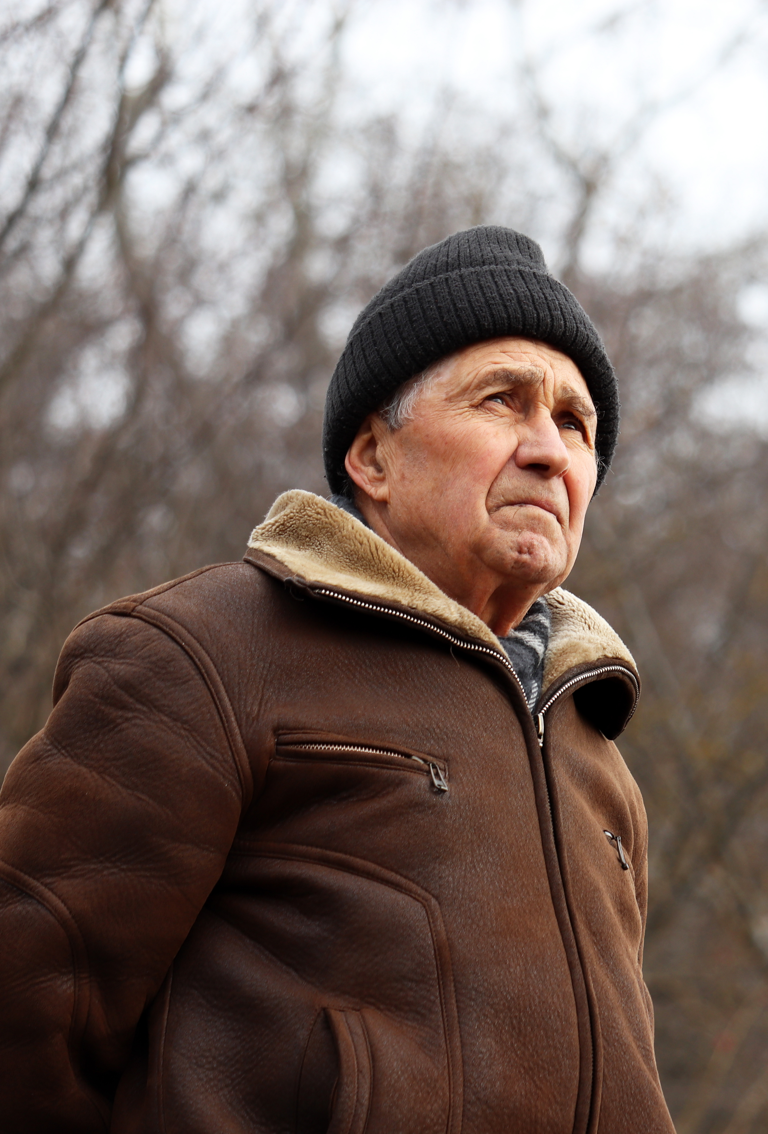
Housing and Affordability Pressures
  1 in 4 seniors live on incomes less than $24,000
  Half of B.C. seniors live on less than $37,000 a year
    by comparison, prime working-age income is nearly $63,000
  Applications for seniors subsidized housing increased 52% over six years.
    Only 7% of applicants received a unit last year
  Housing subsidies like Shelter Aid for Elderly Renters not keeping pace with rising rents
Notes:
Median Income – Statistics Canada, Income Tax filing data (2022)

Slide 7

Ageing in Place: Home Support Under Strain
Over the last 6 years:
16%↑ in people receiving home support
7%↓ in client rate per 1,000 population (75+)
A senior earning $30,000 per year, will pay about $9,000 annually for 1 hour of home support per day
(nearly 30% of income)
Most provinces do not charge for home support, incl. Ontario and Alberta

Slide 8
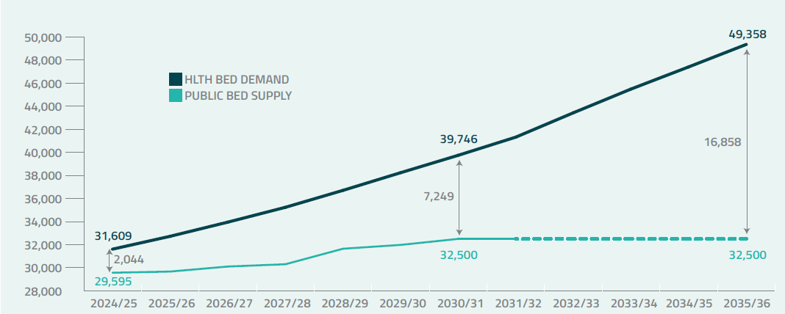
Falling Short of Long-Term Care Targets
Since 2019/20:
5%↑ in the number of long-term care beds
19%↑ in the population of seniors 65+
MINISTRY OF HEALTH PROJECTED PUBLICLY-SUBSIDIZED LONG-TERM CARE BED DEMAND

Slide 9
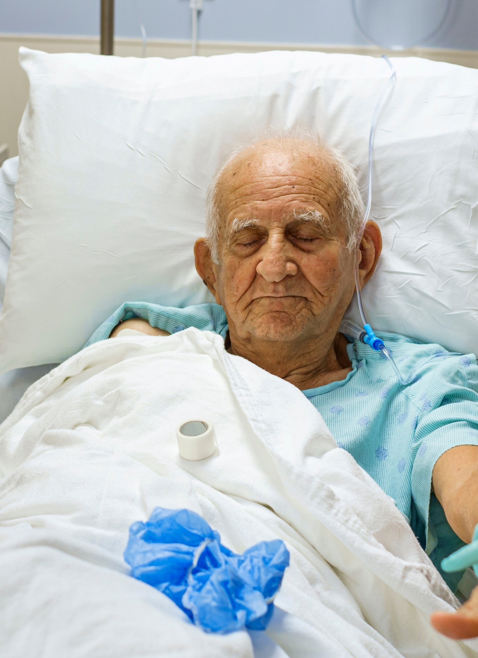
Hospitals Under Pressure
20,449 alternate level of care (ALC) patients 65+ last year
  14%↑ over six years
5,900 ALC patients (65+) waited in hospital for a long-term care bed (2024/25)
  average hospital stay 38 days
  5 days longer than six years ago

Slide 10


Cost of Keeping Seniors in Hospital
Based on the same 5,900 seniors waiting for long-term care:
Hospital (ALC)
Long-Term Care
$1,200/day
5 extra days
$35 million total
$294/day
same 5 days
$9 million total
$27 million net difference
4 X more expensive

Slide 11







Domino Effect of Long-Term Care Wait Times
Emergency department – increased pressure and wait times
Hospitals – increased wait time for surgeries, waiting in beds for admission to long-term care, more hallway medicine
Family doctors – difficulty securing appointments, time delays to manage complexity of frail, elderly care
Ambulance service - more demand, increased response times
Employers – caring for ageing family members leads to increasing absenteeism, reduced ability to work full- time
Families – financial stress, health and well-being suffer
Seniors – receiving inadequate care

Slide 12
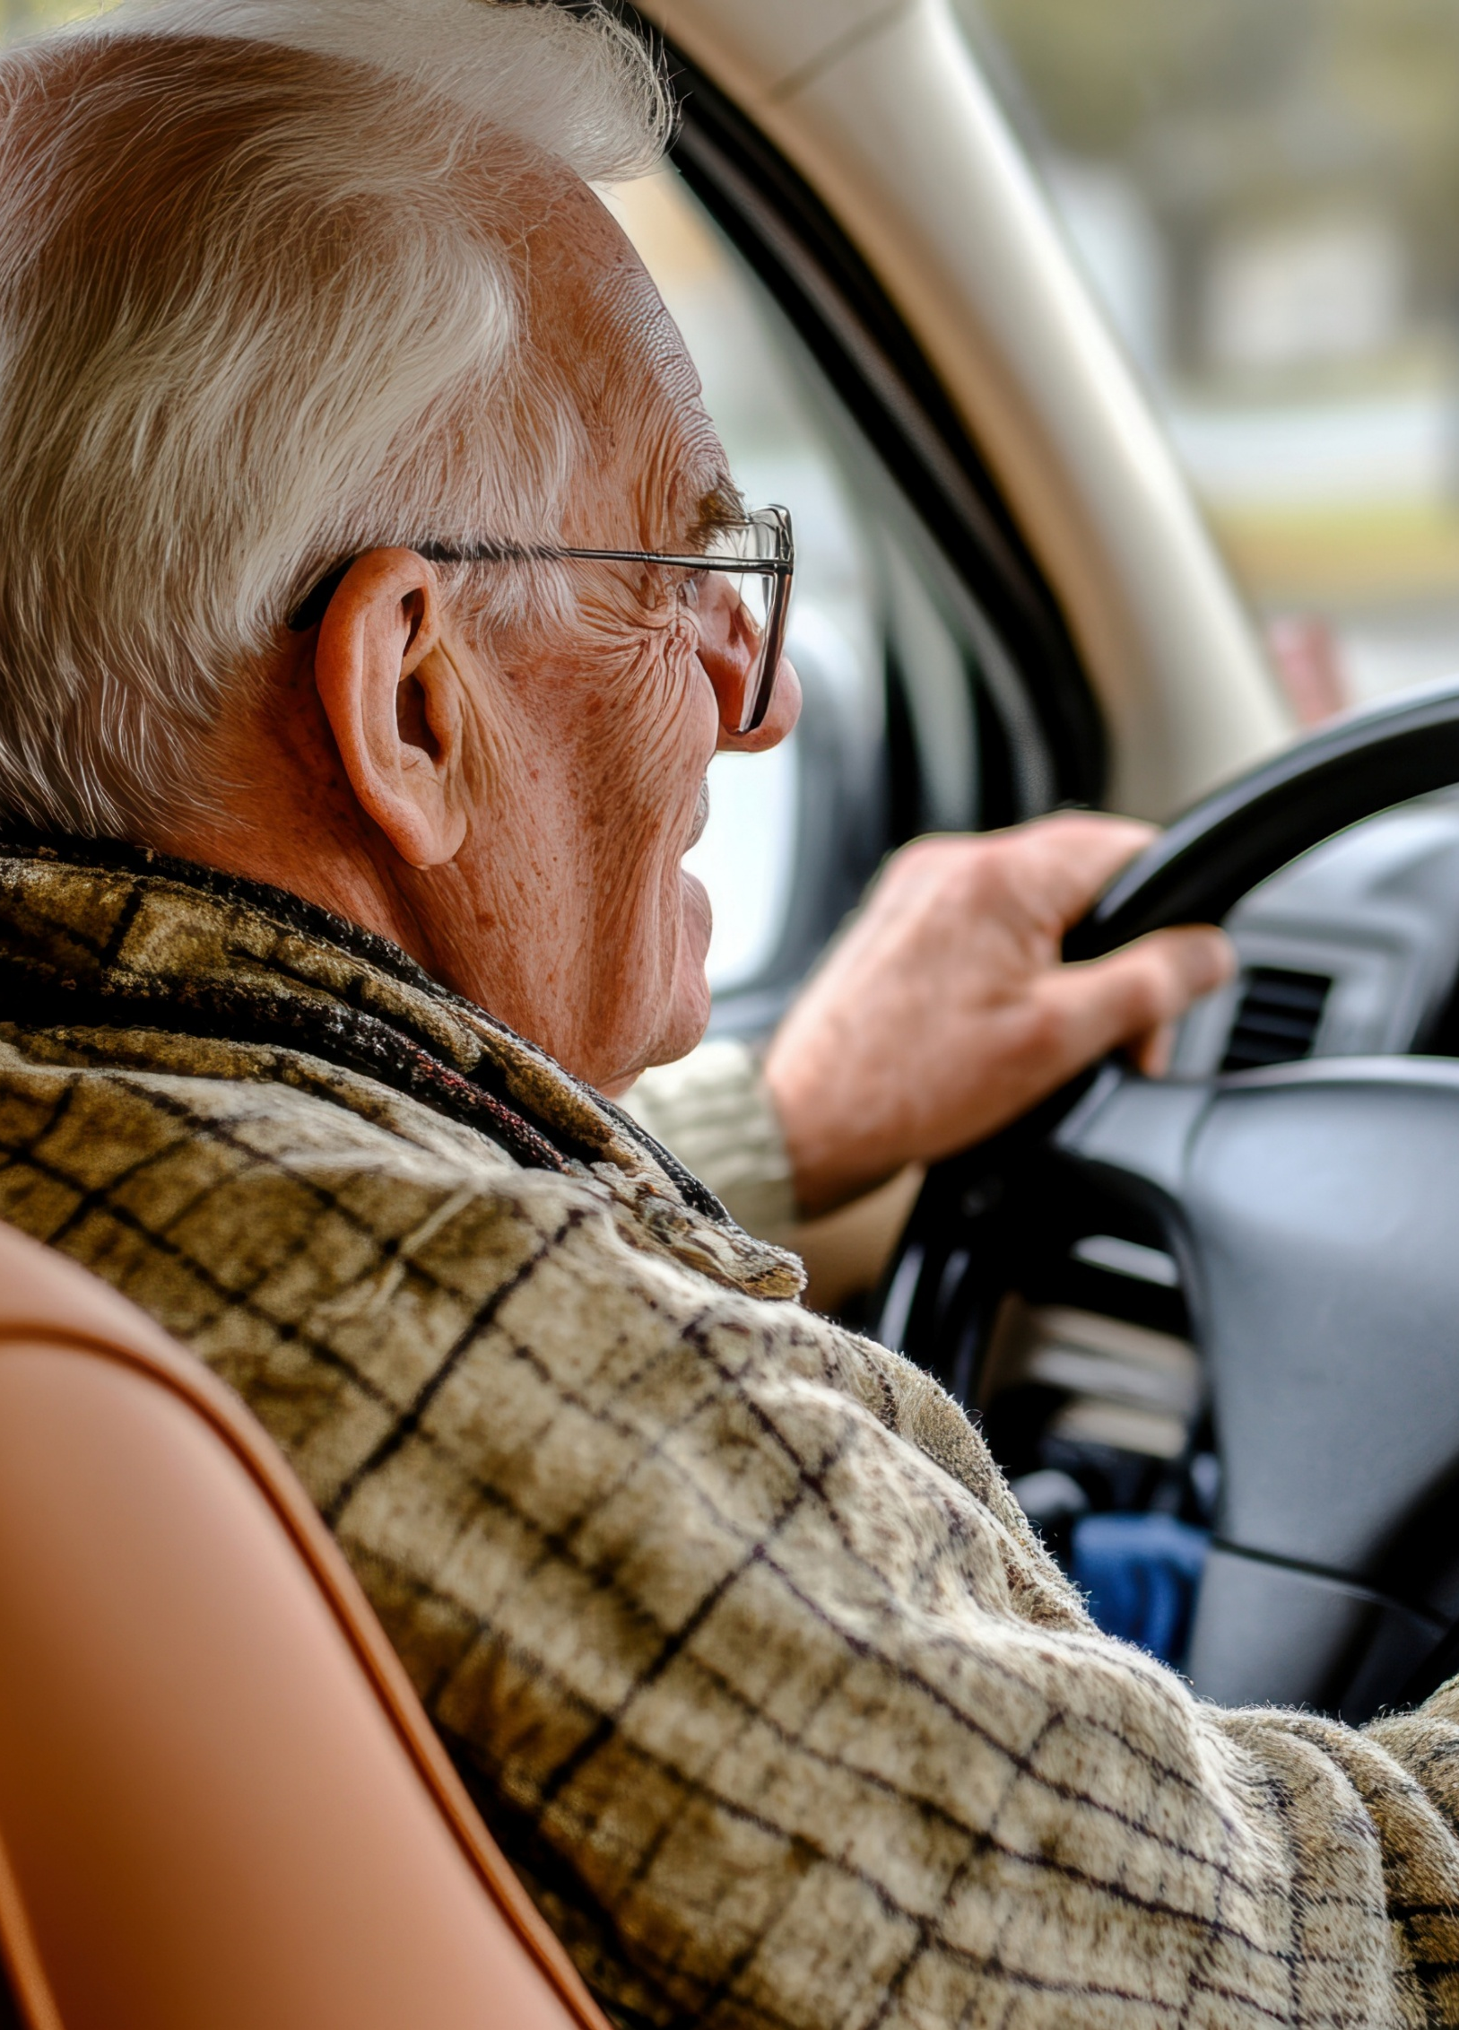
Senior Drivers in B.C.
Driver’s Medical Examination Report (DMER) must be completed by doctor or nurse practitioner at age 80, 85 and every 2 years thereafter
RoadSafetyBC sends a letter and a form in the mail with instructions to take the form to an appointment with the doctor or nurse practitioner
Examination may include tests for eyesight, physical health, cognition, etc., but NOT a road test
MSP does not cover the cost of the examination and doctors may charge for them
Most doctors charge around $253, but there is a wide range across the province
Some drivers may be asked to complete an Enhanced Road Assessment with a road test if there are further concerns

Slide 13

Challenging Myths About Ageing
Older people are unhappy
Seniors are wealthy
MYTH
Memory loss is normal
Seniors can’t use technology
Older workers aren’t as effective

Slide 14

Challenging Myths About Ageing
Older people are unhappy
Life satisfaction often increases with age
Seniors are wealthy
Many live on low or fixed incomes
MYTH
Dementia is not a normal part of ageing
Truth
Memory loss is normal
Seniors can’t use technology
Seniors are more tech-savvy than ever
Older workers aren’t as effective
Skills, experience, and productivity are not determined by age

Slide 15





Contact
Toll-free: 1-877-952-3181
In Victoria: 250-952-3181
Mon - Fri: 8:30 a.m. – 4:30p.m.
www.seniorsadvocatebc.ca
info@seniorsadvocatebc.ca
/SeniorsAdvocateBC
@SrsAdvocateBC
/Office-of-the-Seniors-Advocate-BC

